Slide 1
Fundamental Technology for Information Era of the Next 100 Years – Past, Now and Future of Semiconductor Research
資訊時代未來一百年的基礎科技-半導體研究-的前世今生與未來
Samuel C. Pan, 潘正聖
University/External Research
R&D, TSMC, 3/25/2013
1
Notes:
1

Slide 2
Samuel C. Pan 潘正聖, sam_pan@tsmc.com
伊利諾大學香檳分校電機博士/碩士, 1986/84
台灣大學電機學士, 1980
Cell 0972-299399
台積電職務
技術處長 大學/外部研究 12/09 –
技術處長 設計/技術平台 11/10 – 12/08
處長 先進產品工程處 03/06 – 11/10
  0.11um/90/80/65/55/45/40/32/28nm 技術開發中良率提升
  管理及解決積體電路產品/載具各種設計與製程/元件技術問題
過去經歷
協理 旺宏電子技術開發中心 99/01-03/06
副處長 旺宏電子品質可靠處 96/11-98/12
資深設計工程師 英特爾技術開發處 95/01-96/11
資深元件工程師 英特爾技術開發處 87/03-94/12
客座助理教授 伊利諾大學香檳分校電機系 86/08-87/02
2

Slide 3
History of Technology 技術史
The Neolithic Revolution 新石器革命 12,000年前
The Renaissance Revolution 文藝復興時期的革命 14-16th 世紀
The Agricultural Revolution 農業革命 15-19th世紀
The First Industrial Revolution 第一次工業革命 1760-1840
The Second Industrial Revolution 第二次工業革命 20th世紀
  Atomic Age 原子時代
  Jet Age 噴射機時代
  Space Age 太空時代
  Digital Revolution 數位革命
  Information Age 資訊時代
  Social Age 社交時代
The Third Industrial Revolution 第三次工業革命 21st世紀?
今日重點
Industrial Revolution ,Wikipedia
Notes:
3

Slide 4
20世紀的重要發明
20th century
• 1903: 飛行器的發明 by Wright brothers.
1910s
• 1915: 坦克的發明by Ernest Swinton.
1940s
• 1947: 電晶體的發明 by John Bardeen Walter Brattain and William Shockley
1950s
• 1951: 核能發電的發明
• 1955: 貨櫃運輸的發明 by Malcom McLean
• 1957: 首台個人電腦 by IBM.
• 1958-59: 積體電路的發明 by Jack Kilby and Robert Noyce.
1960s
• 1964: 半導體摩爾定律的預測 by Gordon Moore
1970s
• 1972: 首台視頻遊戲機 Magnavox Odyssey.
• 1973: 圖形用戶界面問世 by Xerox.
1980s
• 1982: 首台CD-ROM的發明 by Sony and Philips.
1990s
• 1990: World Wide Web的發明 by Tin Berners-Lee in 瑞士日内瓦.
• 1995: 首台DVD的發明 by Philips, Sony, Toshiba, and Panasonic
Timeline of Historical Inventions, Wikipedia
Notes:
4

Slide 5
The Third Industrial Revolution: Everything About New Energy Sources第三次工業革命：關於新能源的一切
Shifting to Renewable Energy 改用可再生能源
Converting Buildings into Power Plants 讓建築物變成發電廠
Hydrogen and Other Energy Storage Technology 氫和其他能源儲存技術
Smart Grid Technology 智能電力網技術
Plug in, Electric, Hybrid, and Fuel Cell based Transportation 電動、油電混合和燃料電池為基礎的運輸工具
Energy Conservation for All Technological Inventions to Date 所有科技皆要以節約能源為考量
The Third Industrial Revolution ,Wikipedia
Notes:
5

Slide 6
Prelude (前言)
話說從十九世紀中~
Notes:
6

Slide 7
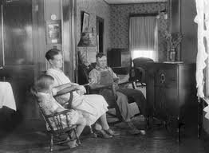
Home Life in Early Twentieth Century在二十世紀初的家居生活
Sometimes I wish life was this simple again...有時候，我真希望家居生活能如此簡單…

Slide 8
More monumental discoveries and inventions by pioneering scientists and engineers starting from 1900 lead to the dawn of Information Age and accelerating ever since…從1900年初起，世界級頂尖科學家與工程師們空前重大發現和發明，逐年累積進而開啟了資訊時代的曙光，並持續加速成長...
Notes:
8

Slide 9
Key Scientific Discoveries since 1900 重要科學發現
1900 – Max Planck: Planck‘s law of black body radiation, basis for quantum theory 馬克斯·普朗克 黑體輻射
20th century
1905 – Albert Einstein: theory of special relativity, explanation of Brownian motion, and photoelectric effect 愛因斯坦 光電效應
1906 – Walther Nernst: Third law of thermodynamics
1909 – Fritz Haber: Haber Process and also Robert Andrews Millikan to determine the charge on an electron
1911 – Ernest Rutherford: Atomic nucleus
1911 – Heike Kamerlingh Onnes: Superconductivity
1912 – Alfred Wegener: Continental drift
1912 – Max von Laue : x-ray diffraction
1913 – Henry Moseley: defined atomic number
1913 – Niels Bohr: Model of the atom 波爾原子模型
1915 – Albert Einstein: theory of general relativity – also David Hilbert
1915 – Karl Schwarzschild: discovery of the Schwarzschild radius leading to the identification of black holes
1918 – Emmy Noether: Noether's theorem – conditions under which the conservation laws are valid
1920 – Arthur Eddington: Stellar nucleosynthesis
1924 – Wolfgang Pauli: quantum Pauli exclusion principle 量子包立不相容原理
1924 – Edwin Hubble: the discovery that the Milky Way is just one of many galaxies
1925 – Erwin Schrödinger: Schrödinger equation (Quantum mechanics) 薛丁格方程式（量子力學）
1927 – Werner Heisenberg: Uncertainty principle (Quantum mechanics) 海森堡測不準原理（量子力學）
1927 – Georges Lemaître: Theory of the Big Bang
1928 – Paul Dirac: Dirac equation (Quantum mechanics) 狄拉克方程（量子力學）
1929 – Edwin Hubble: Hubble's law of the expanding universe
1929 – Lars Onsager's reciprocal relations, a potential fourth law of thermodynamics
1934 – James Chadwick: Discovery of the neutron
1934 – Clive McCay: Calorie Restriction extends the maximum lifespan of another species
1938 – Otto Hahn and Fritz Strassmann: Nuclear fission
1943 – Oswald Avery proves that DNA is the genetic material of the chromosome
1947 – William Shockley, John Bardeen and Walter Brattain invent the first transistor 發明第一顆電晶體
For a comprehensive review, refer to Professor C. T. Sah’s article, “Evolution of the MOS Transistor-From Conception to VLSI”, P. 1280-1326, PROC. OF THE IEEE, VOL. 76, NO. IO, OCTOBER 1988
Timeline of scientific discoveries, Wikipedia

Slide 10
Key Scientific Discoveries since 1900 continued
1948 – Claude Elwood Shannon: 'A mathematical theory of communication' a seminal paper in Information theory.
1948 – Richard Feynman, Julian Schwinger, Sin-Itiro Tomonaga and Freeman Dyson: Quantum electrodynamics 量子電動力學
1951 – George Otto Gey propagates first cancer cell line, HeLa
1952 – Jonas Salk: developed and tested first polio vaccine
1953 – Crick and Watson: helical structure of DNA, basis for molecular biology
1963 – Lawrence Morley, Fred Vine, and Drummond Matthews: Paleomagnetic stripes in ocean crust as evidence of plate tectonics (Vine-Matthews-Morley hypothesis).
1964 – Murray Gell-Mann and George Zweig: postulate quarks leading to the standard model
1964 – Arno Penzias and Robert Woodrow Wilson: detection of CMBR providing experimental evidence for the Big Bang
1965 – Leonard Hayflick: normal cells divide only a certain number of times: the Hayflick limit
1967 – Jocelyn Bell Burnell and Antony Hewish discover first pulsar
1984 – Kary Mullis invents the polymerase chain reaction, a key discovery in molecular biology.
1986 – Karl Müller and Johannes Bednorz: Discovery of High-temperature superconductivity
1994 - Andrew Wiles proves Fermats Last Theorem
1995 – Michel Mayor and Didier Queloz definitively observe the first extrasolar planet around a main sequence star
1995 - Eric Cornell, Carl Wieman and Wolfgang Ketterle attained the first Bose-Einstein Condensate with atomic gases, so called fifth state of matter at extremely low temperature.
1997 – Roslin Institute: Dolly the sheep was cloned.
1997 – CDF and DØ experiments at Fermilab: Top quark.
1998 – Gerson Goldhaber and Saul Perlmutter observed that the expansion of the universe is accelerating.
21st century
2001 – The first draft of the human genome is completed.
2001 - Self Healing Materials by Keneth Matsumura.
2007 - James Thomson of the University of Wisconsin reported that they had reprogrammed regular skin cells to behave just like embryonic stem cells.
2010 – J. Craig Venter Institute creates the first synthetic bacterial cell.
2010 - The Neanderthal Genome Project presented preliminary genetic evidence that interbreeding did likely take place and that a small but significant portion of Neanderthal admixture is present in modern non-African populations.
2012 - Higgs Boson is discovered at CERN (confirmed to 99.999% certainty)
Timeline of scientific discoveries, Wikipedia

Slide 11
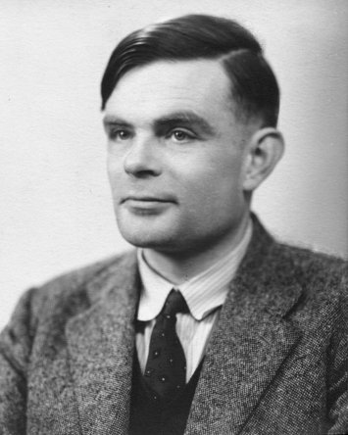
Alan Mathison Turing
Alan Mathison Turing, 23 June 1912 – 7 June 1954), was a British mathematician, logician, cryptanalyst, and computer scientist. He was highly influential in the development of computer science, giving a formalization of the concepts of “algorithm” and “computation” with the Turing machine, which can be considered a model of a general purpose computer. Turing is widely considered to be the father of computer science and artificial intelligence. 1912年6月23日 - 1954年6月7日），是英國數學家，邏輯學家，密碼分析和計算機科學家，對於計算機科學的發展極具影響力。他的”Turing machine”給予”algorithm”和 “computation” 嚴謹的數學描述，被公認是通用的計算機模型。他被廣泛認為是計算機科學和人工智能慧之父。
Wikipedia

Slide 12
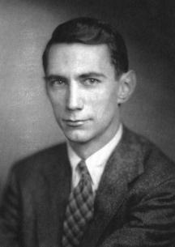
Claude Elwood Shannon
Claude Elwood Shannon (April 30, 1916 – February 24, 2001) was an American mathematician, electronic engineer, and cryptographer known as "The father of information theory".
Shannon is famous for having founded information theory with a landmark paper that he published in 1948. However, he is also credited with founding both digital computer and digital circuit design theory in 1937, when, as a 21-year-old master‘s degree student at the Massachusetts Institute of Technology (MIT), he wrote his thesis demonstrating that electrical applications of boolean algebra could construct and resolve any logical, numerical relationship. It has been claimed that this was the most important master’s thesis of all time. Shannon contributed to the field of cryptanalysis for national defense during World War II, including his basic work on codebreaking and secure telecommunications. （1916年4月30日 - 2001年2月24日）是美國數學家，電子工程師，密碼專家，被稱為”信息理論之父”。除了以1948年發表的資訊理論聞名於天下外，他21歲時，出版有關應用電子裝置以布林代數實現邏輯與數值運算的論文，也被認為是計算機和數位電路設計理論的始祖。此1937年論文被稱為有史以來最重要的碩士論文。他在密碼分析領域上，對國防也做出貢獻，其中包括二戰期間有關破譯密碼和電信安全的基礎工作。
Wikipedia

Slide 13
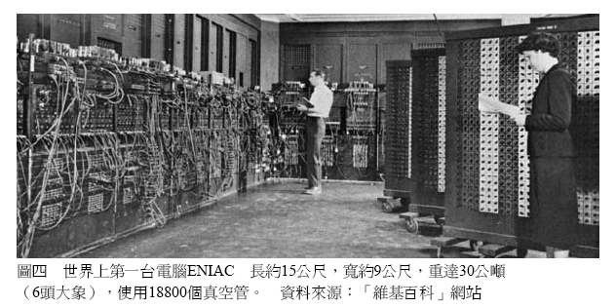
ENIAC, World’s First General Purpose Computer in 1946世界首台通用計算機
Speed: 100K additions/subtractions per second with vacuum tubes burned out almost every day 速度：每秒100K次加/減運算且幾乎每天都燒壞了幾個真空管
奇普士的異想世界 第一篇 “矽”說從頭 電子電機的前世”晶”生

Slide 14
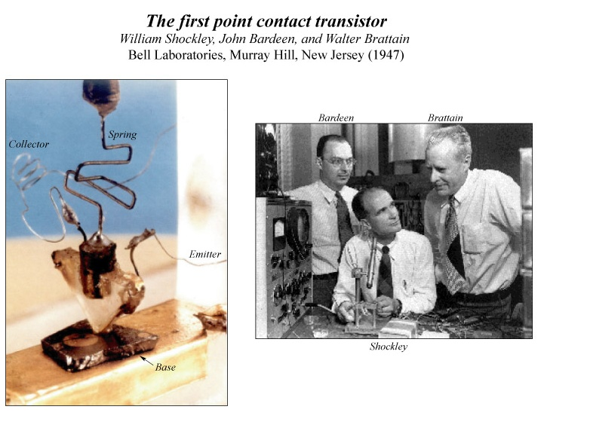
世界首顆電晶體

Slide 15
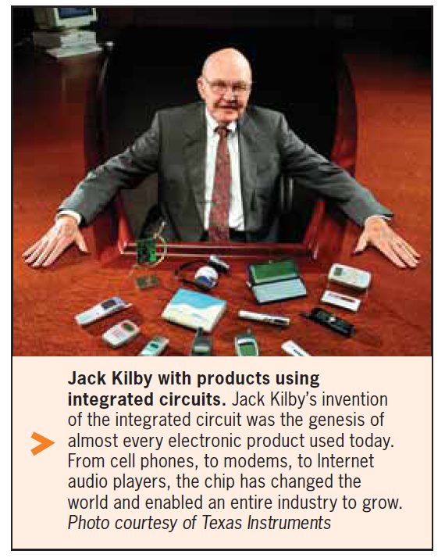
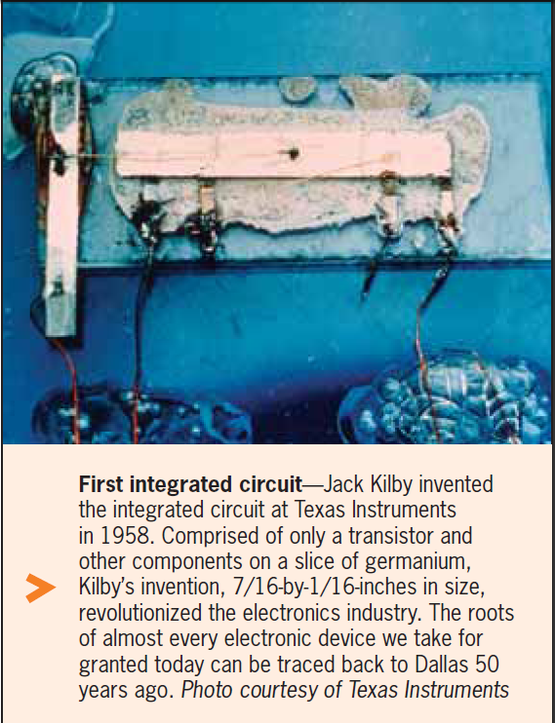
Very First Integrated Circuit in 1958世界第一片積體電路

Slide 16
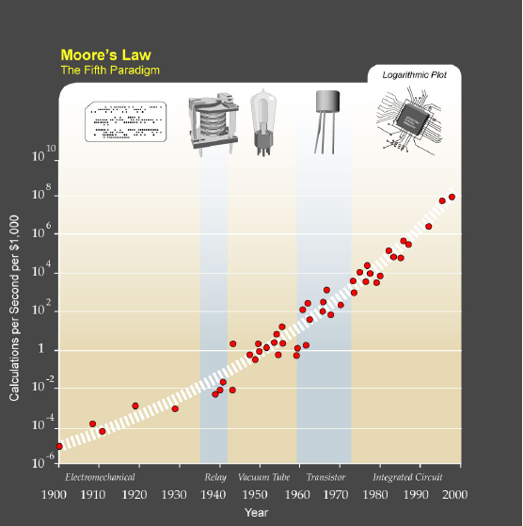
Exponential Growth of Processing Power Enabled by Moore’s Law 摩爾定律讓運算能力呈指數增長
Traditional next generation challenges
0.7x feature size
Transistor Ion/Ioff
SiO2 gate leakage
Device variations
Interconnect
Power dissipation
傳統的下一世代挑戰
尺寸微縮0.7倍問題
電晶體電流開關問題
二氧化矽閘極漏電問題
元件特性的變異性問題
金屬導線問題
功耗問題
IC scaling forecast by Moore’s Law
As size scales below 100nm, mounting challenges…當尺寸小過100nm後，挑戰
重重…
Moore’s Law, Wikipedia

Slide 17
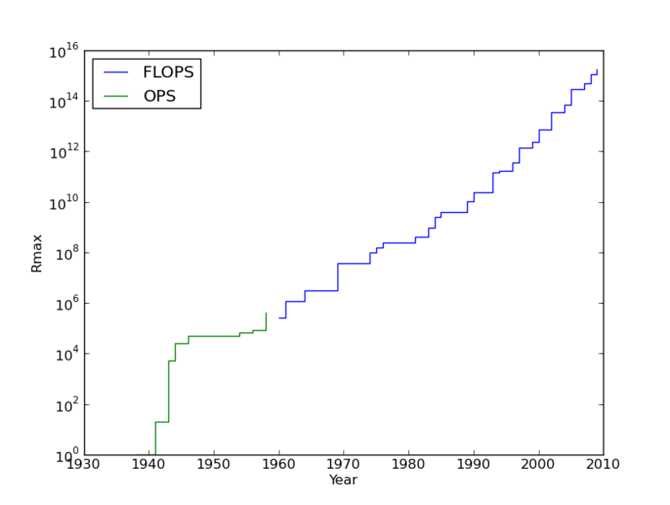
Top Supercomputer Speeds in 60+ years 60多年來頂級超級計算機速度演變
Multi-core PC, smart phone
Cray-X MP
Cray-1
Fastest as of today 現今最快電腦: Cray Titan, 17.59 PFLOPS (17.59 x10¹⁵科學運算)
Supercomputer, Wikipedia

Slide 19
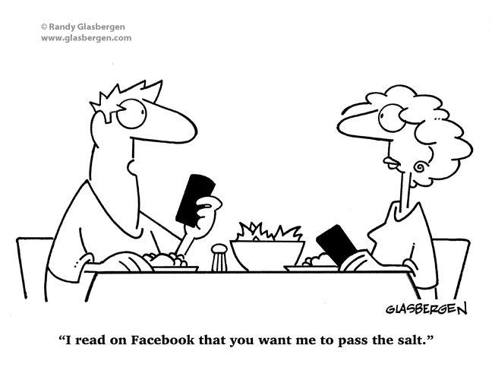
Unimaginable Applications of Information Technology in 21st Century
21世紀資訊技術的應用超越想像
我的臉書說你要我把鹽遞給你

Slide 20
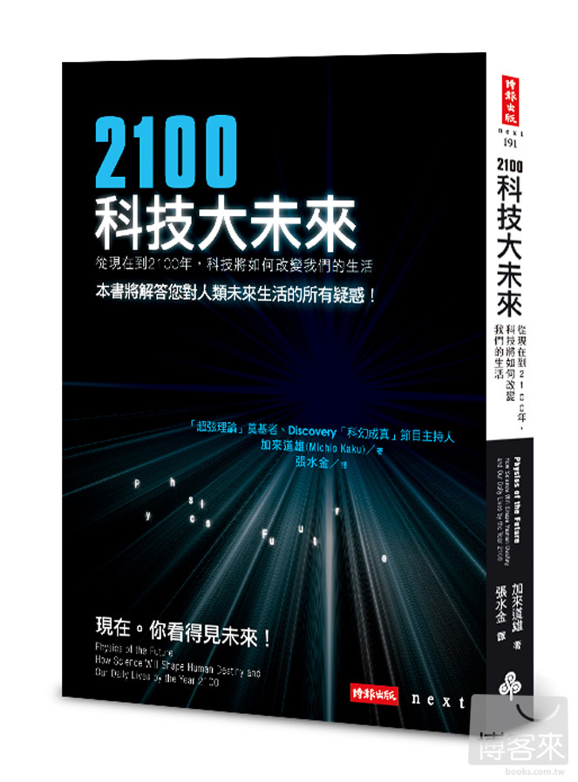
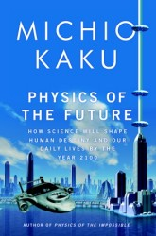

Slide 21
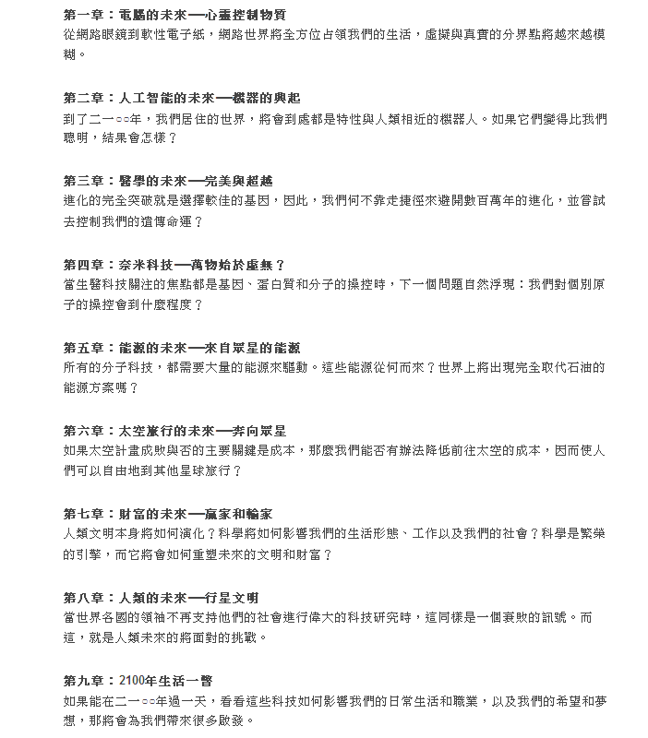
2100 科技大未來
Points to research of 指出下列研究方向
Nano semiconductor material 奈米半導體材料
Nanoelectronics 奈米電子
Very large scale hardware design on a single chip 超大型單晶系統積體電路設計
Robotics, artificial Intelligence and software 機器人、人工智慧及軟體
Sensor/actuator 感測元件
Bio-medical/genetics生醫
Nano material with atomic controllability for device, bio function and manufacturing 奈米系統
New energy? 新能源
Social issues? 社會問題
Moral issues? 倫理問題
Human destiny? 人類未來
21

Slide 22
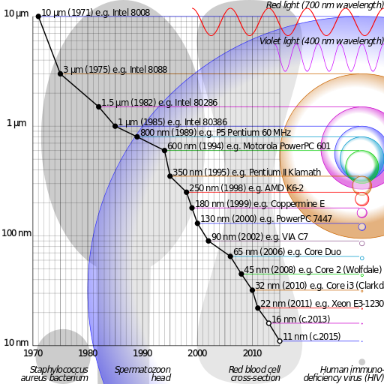
Semiconductor Technology Nodes半導體技術世代
紅光
紫光
細菌
精子
紅血球
AIDS病毒
Semiconductor device fabrication, Wikipedia

Slide 23
Geometry scaling to End 2015-2025尺寸微縮將在2015-2025年內中止
On 13 April 2005, Gordon Moore stated in an interview:
In terms of size [of transistors] you can see that we're approaching the size of atoms which is a fundamental barrier, but it'll be two or three generations before we get that far—but that's as far out as we've ever been able to see. We have another 10 to 20 years before we reach a fundamental limit.
Note that ITRS in 2012 forecast 10nm node at 2015 and 7nm, 2017 with novel structures (FinFET, QwFET, TFET…) and non-conventional material (Ge, IIIV.. on silicon substrate)
2005年4月13日，戈登·摩爾（Gordon Moore）在接受記者採訪時表示：
就電晶體尺寸而言，我們正在接近原子的大小，這是一個根本性的障礙，我們大概還可以微縮兩或三代，這是我們現在的預測。我們再10到20年就會碰到這個基本的限制。
請注意，2012年國際半導體技術藍圖預測，在2015及2017年時，將分別會出現具有新穎結構（FinFET，QwFET，TFET…）和非傳統材料（在矽晶片上長出Ge,IIIV…）的7nm和10nm的世代

Slide 24
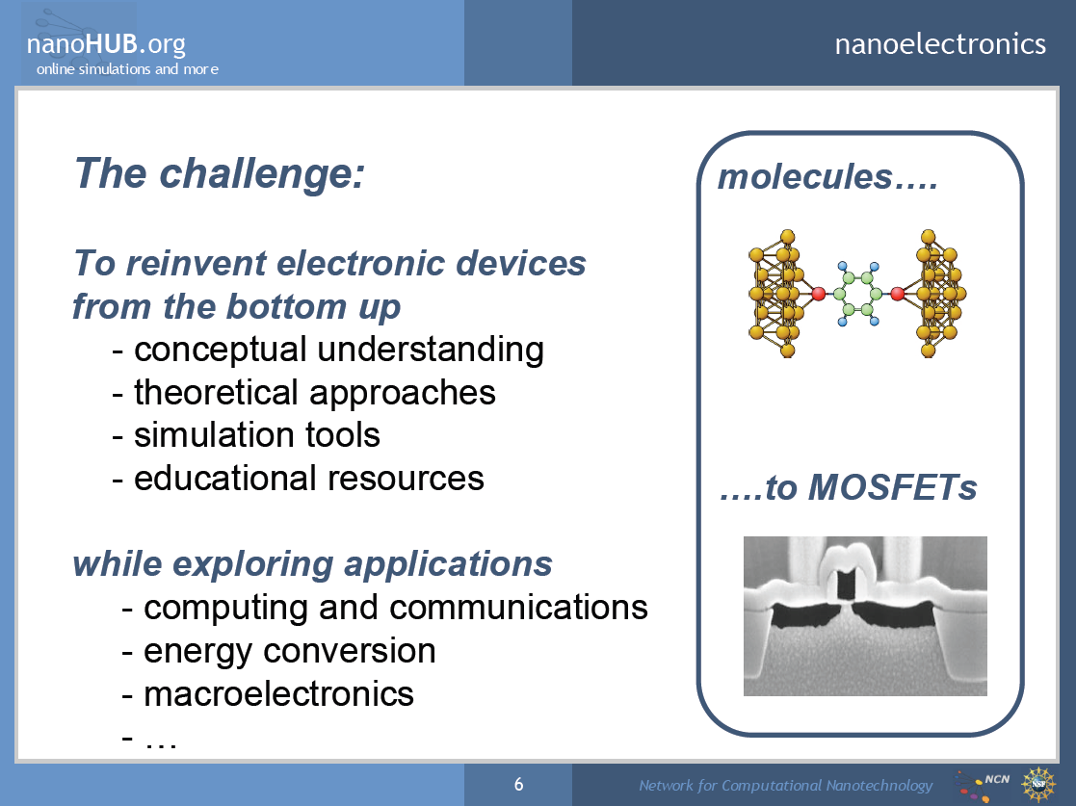
挑戰
分子
從基礎物理再重新發明新的電子元件
了解觀念
理論探討
模擬工具
金氧半電晶體
教育資源
並探索各種應用
計算和通訊
能量轉換
電子產品
24

Slide 25
21st Century: Quantum Age 21世紀: 量子時代
Within next 10 years, Moore’s Law is to hit mesoscopic scale, where Quantum Physics rules. Spectacular Information growth in 20th Century can continue to expand if authentic engineering of Quantum Physics prevails
在未來10年，摩爾定律將被數個原子的尺度限制，在如此微小的世界中，一切由量子物理控制。如果貨真價實的量子理論能夠被工程師們巧妙地利用而發明出奈米級量子元件，20世紀爆炸性資訊應用，將能夠繼續成長

